Slide 1

Data Analytics Sports Marketing
Betelihem Lakew

Slide 2
Objective
Business & Data Understanding
to build a scoring model that corresponds to the likelihood of fans not renewing their season tickets, based on the 17 variables the team has provided
To Predict Fans that would defect/Discontinue their Membership

Slide 3
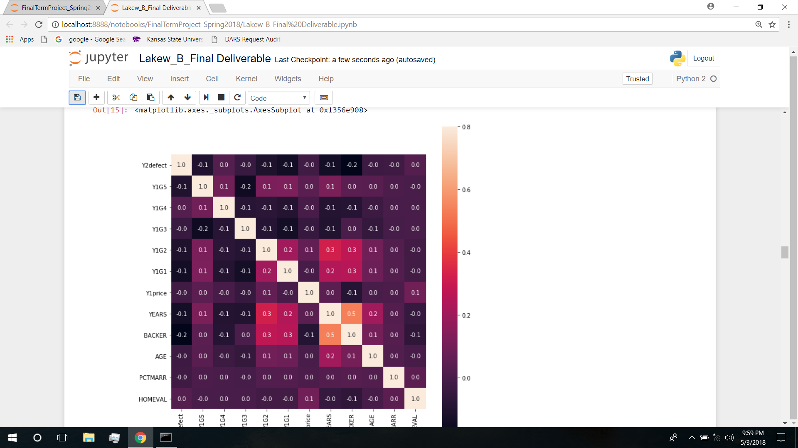
Methodology and Tools
Data visualization/Exploratory data analysis:
Histogram and heat Map
Hypothesis testing
BACKER club membership and YEARS are brighter

Slide 4
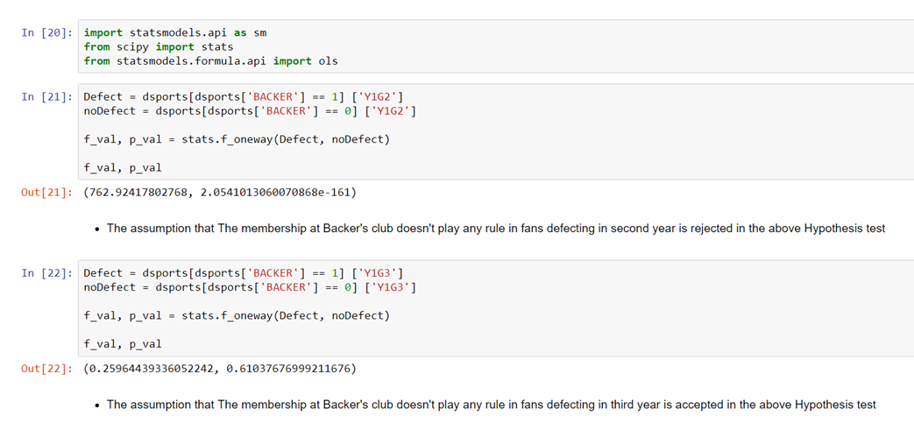
METHODOLOGY (cont’d)

Slide 5
Conclusion
The story behind data
BACKER membership plays a significant role on keeping fans dedicated therefore the Sports marketing department should work closely or segment the market to the need of the club.

